Slide 1
Storage Class
Sini Raj P

Slide 2
Storage Classes are used to describe the features of a variable/function
These features basically include the scope, visibility and life-time which help us to trace the existence of a particular variable during the runtime of a program

Slide 3
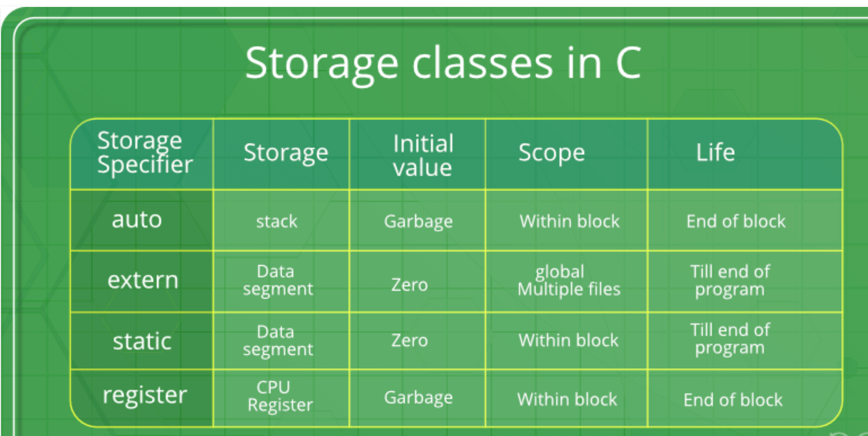
Storage Classess

Slide 4
Auto
auto: This is the default storage class for all the variables declared inside a function or a block.
Hence, the keyword auto is rarely used while writing programs in C language.
Auto variables can be only accessed within the block/function they have been declared and not outside them (which defines their scope).
Of course, these can be accessed within nested blocks within the parent block/function in which the auto variable was declared.
However, they can be accessed outside their scope as well using the concept of pointers given here by pointing to the very exact memory location where the variables resides.
They are assigned a garbage value by default whenever they are declared.

Slide 5
Extern
extern: Extern storage class simply tells us that the variable is defined elsewhere and not within the same block where it is used.
Basically, the value is assigned to it in a different block and this can be overwritten/changed in a different block as well.
So an extern variable is nothing but a global variable initialized with a legal value where it is declared in order to be used elsewhere.
It can be accessed within any function/block.
Also, a normal global variable can be made extern as well by placing the ‘extern’ keyword before its declaration/definition in any function/block.
This basically signifies that we are not initializing a new variable but instead we are using/accessing the global variable only.
The main purpose of using extern variables is that they can be accessed between two different files which are part of a large program.

Slide 6
Static
static: This storage class is used to declare static variables which are popularly used while writing programs in C language.
Static variables have a property of preserving their value even after they are out of their scope!
Hence, static variables preserve the value of their last use in their scope.
So we can say that they are initialized only once and exist till the termination of the program.
Thus, no new memory is allocated because they are not re-declared.
Their scope is local to the function to which they were defined.
Global static variables can be accessed anywhere in the program.
By default, they are assigned the value 0 by the compiler.

Slide 7
Register
This storage class declares register variables which have the same functionality as that of the auto variables.
The only difference is that the compiler tries to store these variables in the register of the microprocessor if a free register is available.
This makes the use of register variables to be much faster than that of the variables stored in the memory during the runtime of the program.
If a free register is not available, these are then stored in the memory only.
Usually few variables which are to be accessed very frequently in a program are declared with the register keyword which improves the running time of the program.
An important and interesting point to be noted here is that we cannot obtain the address of a register variable using pointers.

Slide 8
Syntax Used
Syntax:
storage_class var_data_type var_name;

Slide 9
Extern
The extern modifier is most commonly used when there are two or more files sharing the same global variables or functions

Slide 10
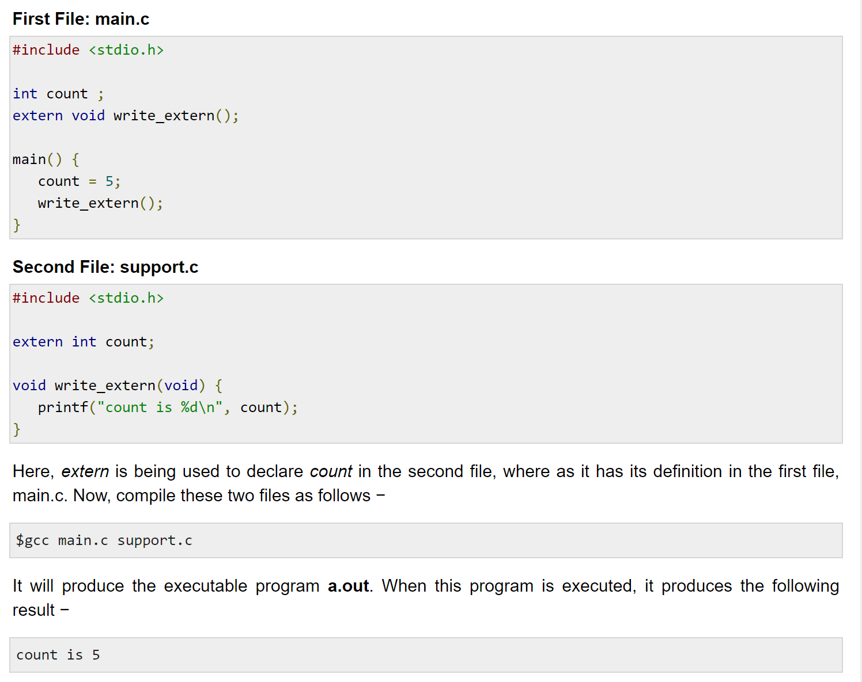
Example

Slide 11
Static Example
#include<stdio.h>
int main()
{
static int i=5;
if(--i){
main();
printf("%d ",i);
}
}

Slide 12
Explanation
The first thing you have to remember is that static variables are initialized only once.
The second thing is that static variables have a life time scope and they retain their value between function calls.
i is first initialized to 5. In the if condition the value of i is changed to 4. main() is called again and the value of i is changed to 3 in the if condition and main is called again. Now the value of i is changed to 2 and main is called again. Now the value of i is changed to 1 and main is called again. After this the value of i is changed to "0" and the block is excited.
As the value of i is now 0, it is printed 4 times for each of the calls for main().
It compiles because main() is just a function like any other function in the code.
So the ans will be 0 0 0 0 .

Slide 13
Explanation in detail
It will expand as follows :
void main()
{
int i = 5
if(--i) //evaluates to 4
{ // First recursion
if(--i) //evaluates to 3
{ //Second recursion
if(--i) //evaluates to 2
{ //Third recursion
if(--i) //evaluates to 1
{ //Fourth recursion
if(--i) //evaluates to 0)
{ //Fifth recursion
//Does not execute.
}
printf("%d", i); //i=0, so prints 0
} //Fourth recursion
printf("%d", i); //i=0, so prints 0
} //Third Recursion
printf("%d", i); //i=0, so prints 0
} //Second recursion
printf("%d", i); //i=0, so prints 0
} //First recursion
}

Slide 14
Example 2
#include <stdio.h>
int main()
{
static int i=5;
if (--i){
printf("%d ",i);
main();
} }

Slide 15
Explanation
4 3 2 1
Explanation: Since i is static variable, it is shared among all calls to main(). So is reduced by 1 by every function call

Slide 16
Example
Which of the following is not a storage class specifier in C?
(A) auto
(B) register
(C) static
(D) extern
(E) Const
Answer: (E)
Explanation: Const is not a storage class specifier. volatile and const are type qualifiers.

